Slide 1
SCHRODERS X READ ALLIANCE
SERVICE MANAGEMENT ALERTING PLATFORM
AUGUST 2019
Notes:
FAYE/ANDREW

Slide 2
DAY 1: GETTING STARTED
Introductions
Workshop outline
Business background
Project management
Technology overview
Intro to Raspberry Pi
Circuits
Raspberry Pi circuit
Notes:
FAYE

Slide 3
INTRODUCTIONS
Name tags
Icebreaker: Who is it?
Everyone write a fun fact about themselves onto a slip of paper and put it into the hat. Each slip will be drawn one by one and the aim is to guess who is the person behind the fact. Once a person’s fact has been read aloud, they will pick the next fact from the hat.
Notes:
FAYE - EVERYONE HERE

Slide 4
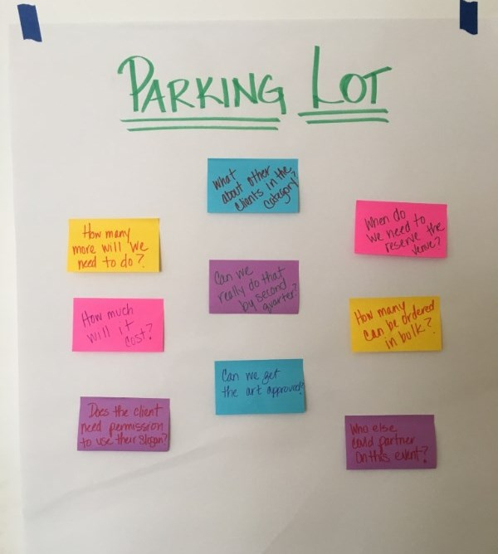
WORKSHOP OUTLINE
What will we be doing?
What will you learn about?
Raspberry Pis
Programming in Python
Project Management
Service Management
What do you want out these workshops?
Notes:
FAYE / ANDREW

Slide 5
BUSINESS BACKGROUND
Thom - what is your team responsible for? How do you know if something breaks?
What do you do today? How can this be improved?
For the group - what do you think can be done?
Notes:
THOM / ANDREW

Slide 6
WHAT IS A PROJECT?
What are examples of projects you’ve had to work on?
Did you like it? Why?
How do you define a project?
Notes:
ANDREW

Slide 7
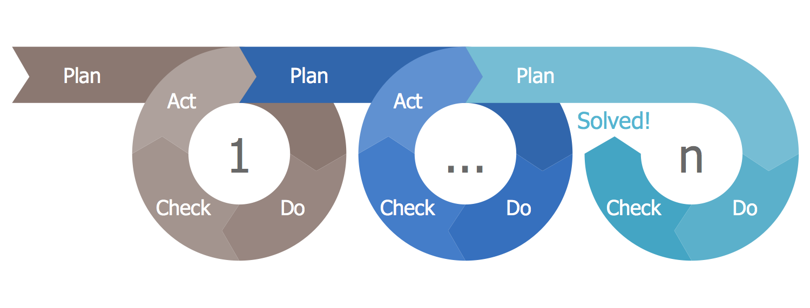
DOING A PROJECT
PLANNING
DOING
REVIEWING
What must be done?
What can be done?
What can we commit to do in the time given with the people and resources we have?
Agree to the scope
List what:
Is pending
Is being worked on
Is done
Blockers / Problems / Issues
Who is fixing these?
What did we expect to do?
Did we do it?
Was it “good enough?”
How can we improve?
Determine actions for improving
Notes:
ANDREW

Slide 8
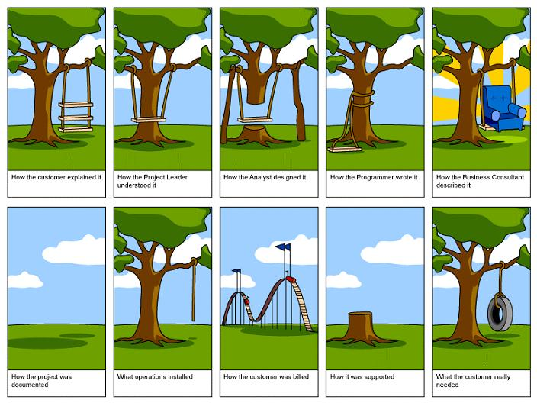
WHY UNDERSTANDING SCOPE IS IMPORTANT
Notes:
ANDREW

Slide 9
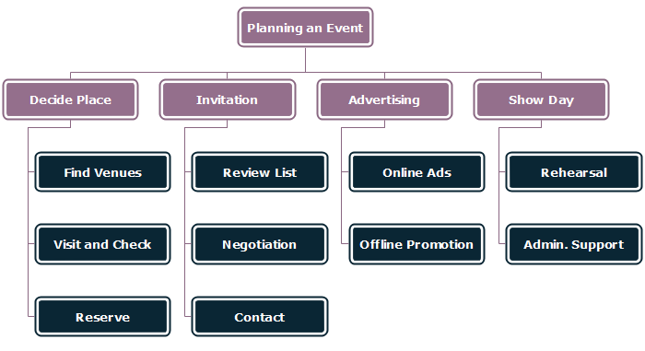
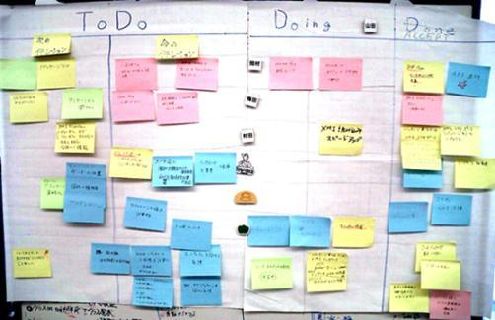
HOW TO DOCUMENT SCOPE
First, let’s try defining scope on your real-life experience
Then, let’s determine the scope of our Service Management Alert Project

Slide 10
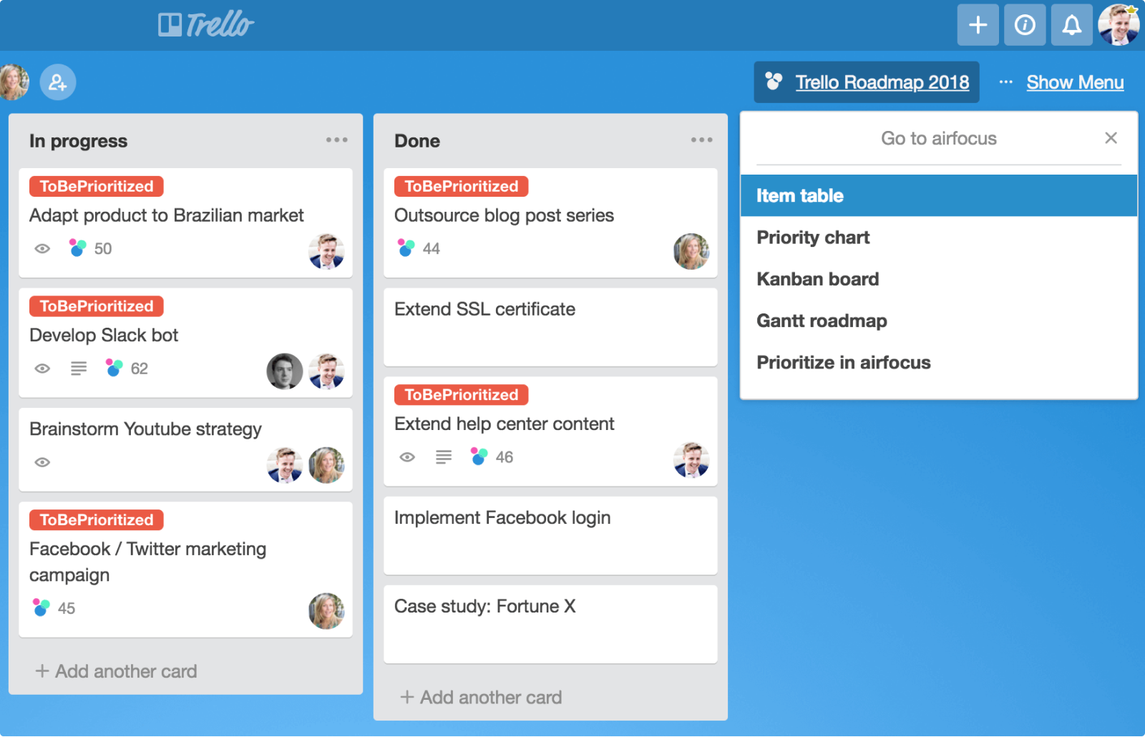
TRACKING TO COMPLETION
Each task must have:
Description
Sequence / Order
If needed, consider:
Due date
Assignment

Slide 11



TECHNOLOGY OVERVIEW
What will we need to build a simple alerting system?
Notes:
VLAD / KALPANA

Slide 12
CIRCUIT SYMBOLS
Notes:
KALPANA / FAYE

Slide 13



CIRCUIT DIAGRAMS
Notes:
KALPANA / FAYE

Slide 14
INTRO TO RASPBERRY PI
1) Plug in
2) Console
3) Clone the repo
Notes:
VLAD / KALPANA

Slide 15
RASPBERRY PI CIRCUIT
What will this look like? Draw the circuit diagram
Now build it!
Notes:
VLAD / KALPANA

Slide 16
Retrospective
Check the parking lot?
What did we learn?
What worked well?
What could we do better?

Slide 17
DAY 2: LET’S CODE!
Recap
Intro to Python
Programming concepts
Functions
Comments
Variables
Error Handling
Create Email To Thom functionality
Send Email by Raspberry Pi
Notes:
FAYE / ANDREW

Slide 18
RECAP
What did we cover yesterday?
Notes:
FAYE / ANDREW

Slide 19
PYTHON
What is Python?
Opening the text editor
The first program: Hello World!
Notice the different colors of the words. Why is that?
Running programs
Notes:
FAYE / KALPANA

Slide 20
PROGRAMMING BASICS
Keywords – which keyword have we already come across?
Strings / Numbers – how can you tell the difference?
Variables – why would you need these?
Comments – why would you need these?
Notes:
FAYE / KALPANA

Slide 21
PROGRAMMING FUNCTIONS
What is a function?
Why use functions?
How do you write a function?
LAB: Pew!
Notes:
ANDREW / SAMI

Slide 22
PROGRAMMING FUNCTIONS
How do you call a function?
How do you use parameters within functions? And why would you want to?
How do you return values from functions? And why would you want to?
Q: What is the difference between a variable, a parameter and a value?
Notes:
ANDREW / SAMI

Slide 23
IMPORTING LIBRARIES
What is a library?
Why would you want to use one?
Where is this code stored?
Can you build your own?
Notes:
ANDREW / SAMI

Slide 24
SENDING AN EMAIL
LAB: Let’s build an email program
Notes:
SAMI / ANDREW

Slide 25
RASPBERRY PI SOFTWARE
1) Copy source code
2) Run the code
3) Explain it
4) Change the code so the light remains on for 5 seconds after pushing button
5) Test it
Notes:
JOSH / VLAD

Slide 26
SEND AN EMAIL
Review and edit the code
To: Thom.Christensen@Schroders.com
Subject: Sending a test email from my raspberry pi
Body: Make something up!
Test it
Embed the code into a function
Test it
Notes:
JOSH /VLAD

Slide 27
BUILD A CLASS
What is a class?
Why would we use classes?
How would you use classes?
What is Object Oriented Programming (OOP)?
Notes:
ANDREW / KALPANA

Slide 28
ENHANCED SEND AN EMAIL
Take your email function and put it in a class
Add functionality to push button to turn on light and send the email when button is pressed
Count the number of times the button is pressed
Save the number of times the button is pressed between reboots
Notes:
SAMI / FAYE

Slide 29
Retrospective
Check the parking lot?
What did we learn?
What worked well?
What could we do better?

Slide 30
DAY 3: WORKING WITH THE BUSINESS
The basics of Service Management
Introduction to ServiceNow
Send an alert to ServiceNow
Reporting on issues
Device Registration
Ticket validation / Preventing Spam
Notes:
ANDREW

Slide 31
RECAP
Notes:
ANDREW

Slide 32




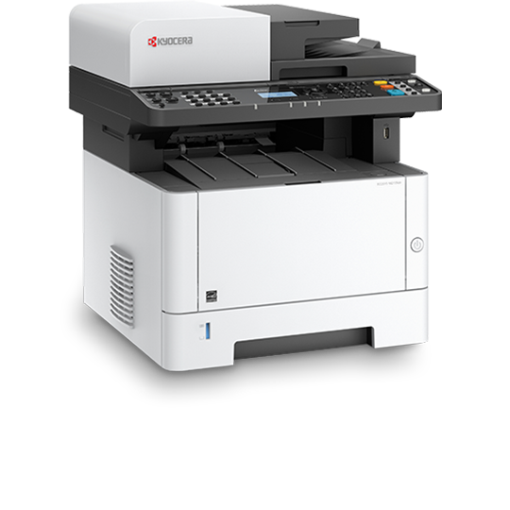




IT Service Management (ITSM)
What is an IT Service ?
Basically, a bunch of techie stuff that allows you to do something useful
Think of any piece of technology you’d use at home or here in the workplace...
What is an IT Service Provider ?
An organization that provides IT systems (or services) to a customer
Notes:
What are IT Services? Think of any piece of technology you’d use in the workplace – your computers, the apps installed on it, the Internet, your phone.
Common perception is that ITSM means IT Support, but ITSM goes way beyond resolving day-to-day issues. ITSM is responsible for the end-to-end management of these services.
IT service provider: An organization that provides IT systems to a user (customer). The organization may be an internal IT department of the company you work for – the people who put the computers on our desks and fix them when they go wrong. Or it could be a commercial organization that provides IT services in exchange for money, an Internet provider like Verizon or a cell phone provider like T-Mobile. In all cases these organizations are providing an IT service to their customers.

Slide 33

IT Service Management (ITSM)
What is IT Service Management ?
All the activities involved in designing, deploying, supporting and improving IT services
Performed by IT Service Providers to enhance the delivery of IT services to it’s customers
Benefits of ITSM ?
Helps to reduce IT downtime
Saves money
Better communication
Makes customers more productive
Increases customer satisfaction
Notes:
That definition comes from something called ITIL, we’ll come onto that a bit later…
Common perception is that ITSM means IT Support, but ITSM goes way beyond resolving day-to-day issues. ITSM is responsible for the end-to-end management of these services.

Slide 34
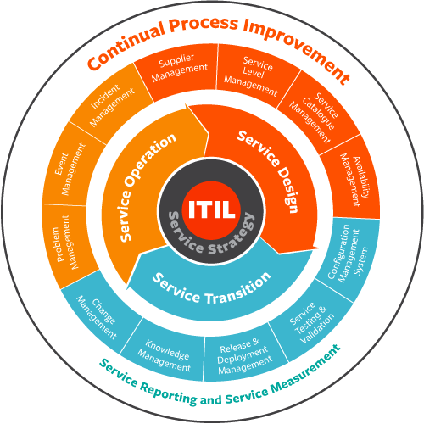
IT Service Management (ITSM)
What is ITIL?
The most widely adopted and recognized body of knowledge for ITSM
ITIL Processes
Incident Management
restore IT service as quickly as possible
Problem Management
prevent Incidents from happening
Configuration Management
maintain information about Configuration Items required to deliver an IT service
Notes:
Information Technology Infrastructure Library
ITIL is the most adopted and recognized body of knowledge for ITSM. ITIL is a best practice framework, made up of 5x core processes, which guide me as an IT Service Manager on how ITSM can be delivered.
Incident Management
to return the IT service to users as quickly as possible
Problem Management
to prevent Incidents from happening
Configuration Management
To maintain information about Configuration Items required to deliver an IT service

Slide 35

What is ServiceNow ?
A software platform which supports IT Service Management
Console vs. Portal
What are the benefits of ServiceNow ?
Standardize
Better visibility
Automate
Notes:
Show console
Show service portal

Slide 36

INCIDENT AUTOMATION
What is an inbound email action?
checks an inbound email for conditions
If the conditions are met, the system triggers the configured action
ServiceNow can take two types of actions:
Record action: setting a value for a field in the target table
Email reply: sending an email back to the source that triggered the action

Slide 37
IDENTIFYING UNIQUE DEVICES
If we placed each device in a different location, how could we tell which button was pressed to trigger an alert?
Notes:
JOSH / VLAD

Slide 38
SEND EMAILS TO SERVICENOW
Notes:
ANDREW / CHRIS

Slide 39
REPEATED TICKETS
Scenario 1: One person notices the coffee machine is broken and presses the button. A second person does the same, and a third person. All within five minutes. Three tickets are raised for one incident.
Scenario 2: One person notices the coffee machine is broken. They really want coffee. They press the button repeatedly twenty times. Twenty tickets are raised for one incident.
Q: How would we avoid these scenarios?
Notes:
KALPANA / SAMI

Slide 40
Retrospective
Check the parking lot?
What did we learn?
What worked well?
What could we do better?

Slide 41
DAY 4: MATURING THE MODEL
Using the Cloud to create ServiceNow tickets
Reporting
Wrapping up
Other things you can do with a Raspberry Pi
Participant Feedback
Notes:
ANDREW

Slide 42
RECAP
Notes:
ANDREW

Slide 43
AZURE
Why use back end system instead of emailing directly?
How do we talk to the back end system?
What is the cloud?
Update the Raspberry Pi to talk to the API to raise a ticket in ServiceNow
Notes:
JOSH /VLAD

Slide 44
REPORTING
Where do you see reporting in your everyday life?
Why is it important?
What does bad/good reporting look like?
What do we want to learn from ServiceNow data
Create your own data visualizations
Notes:
KALPANA /FAYE

Slide 45
OTHER PROJECTS
Alien Invasion
Kodi Media Center
Steam link – stream your PC games to your TV
Alexa: Build your own Amazon Echo/ Google assistant
Pi-hole – network wide ad-blocker
Adafruit for more accessories
Notes:
FAYE / ANDREW

Slide 46
THANK YOU
Thank you for taking part in our first collaboration with Read Alliance.
Please provide any feedback on the forms provided.
Notes:
ANDREW / FAYE

